Slide 1
Innovative methods towards building and evaluating congestion charging scenarios: The case of Metro Vancouver
Ilan Elgar
Fearghal King, Reid Keller, Daniel Firth
Presented at the 17th TRB Plan App Conference,
June 4th, 2019, Portland, OR.

Slide 2
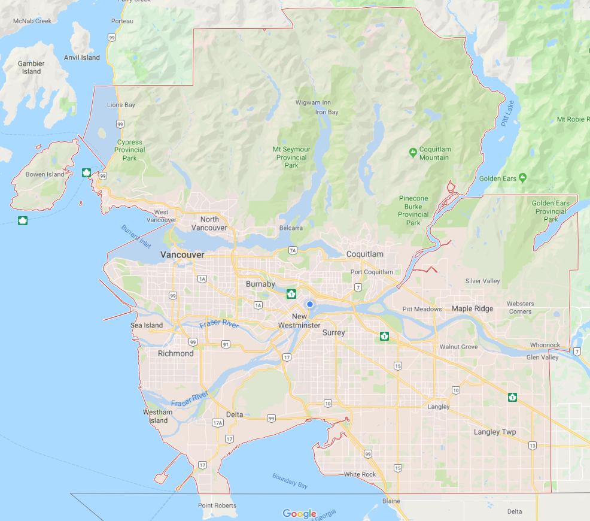
Metro Vancouver regional context
Geographic:
~2,900 km² (~1,100 mi²)
~2.5 million pop. (2016)
Contained by mountains, ocean, and the US border
Governance:
23 local authorities
23 mayors
Regional Transportation Authority (TransLink)
Board of Directors
Mayors’ Council
LOTS OF MOUNTAINS!
LOTS OF
WATER CROSSINGS!
OCEAN
~ 60km (37 miles)
USA
USA

Slide 3
Historical context
June 2017:
Mobility Pricing Independent Commission formed
1993:
Metro Vancouver first endorsed the idea of road pricing
~2012 – 2016:
Vancouver ranked ‘most congested city’ in Canada
Fairness and affordability concerns intensify; some dissent towards TransLink
1998:
TransLink formed
2012:
Port Mann Bridge opens (tolled)
Sept. 2017:
Bridge tolls removed
2013:
Road pricing confirmed in several policy documents (RTS, RGS, Transport 2040) and by the Mayor’s Council
2009:
Golden Ears Bridge opens (tolled)

Slide 4
Commission objectives
The Commission’s work was guided by three core objectives:

Slide 5
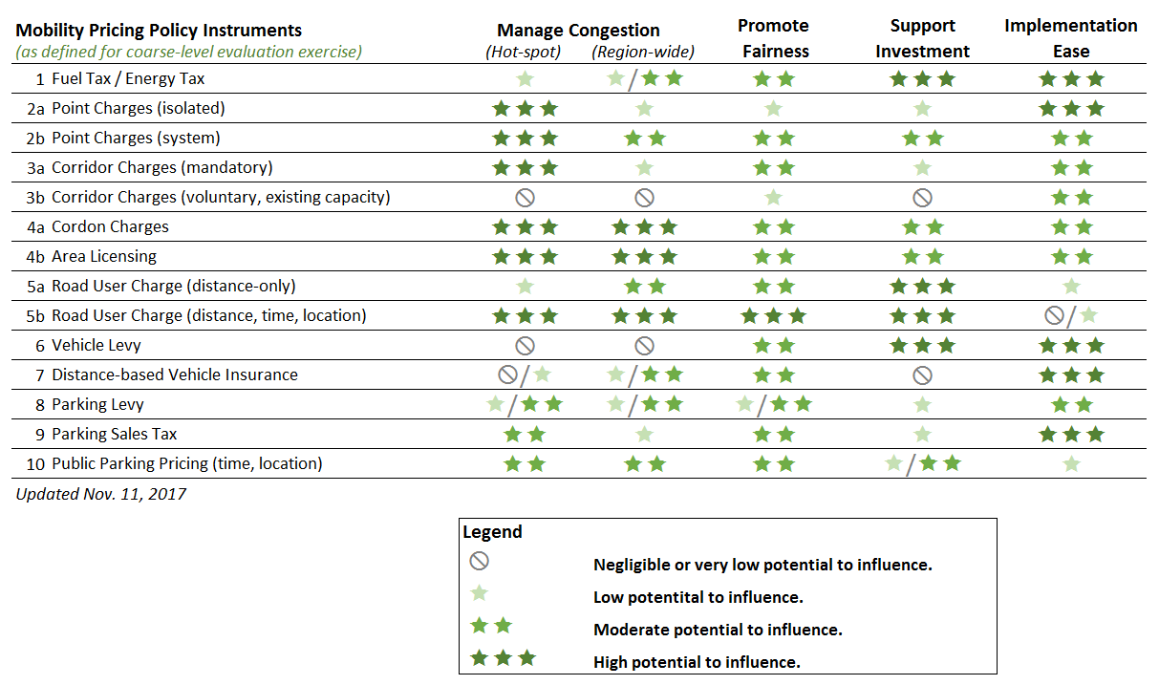
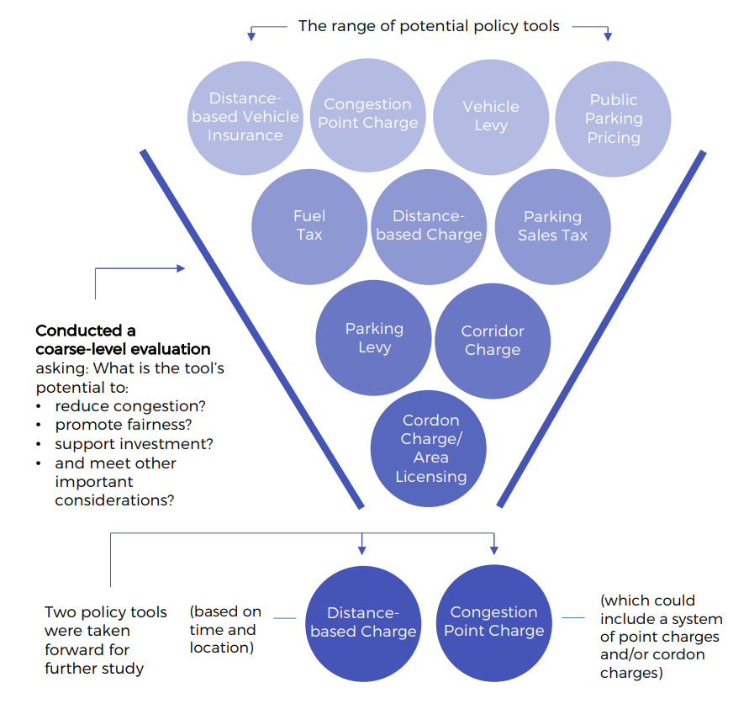
Evaluation framework & analytical approach
IDENTIFY AND REFINE THE LIST OF POTENTIAL POLICY OPTIONS
Coarse-level evaluation
SCENARIO DEVELOPMENT & EVALUATION PROCESS
Illustrative examples
Price-setting in the absence of clear objectives
Iterative development of scenarios to guide and educate MPIC
Development of complex metrics and KPIs
Evaluation exercises and trade-off discussions

Slide 6
Approach towards addressing fairness
User Pay
Principle
Benefiter Pay
Principle
User Cost
Principle
That people should pay in proportion to how much they use the transportation system
That people should pay in proportion to the time savings they experience
That people should pay in proportion to the amount of congestion they contribute to
SIMPLE
COMPLEX
Better aligned with usage
✓ | Flat fee (Temporally) | ✗
✗ | Vary by time of day (TOD) | ✓
✗ | Vary by direction of travel (Dir.) | ✓
✗ | Vary by location | ✓
Better aligned with congestion contribution

Slide 7
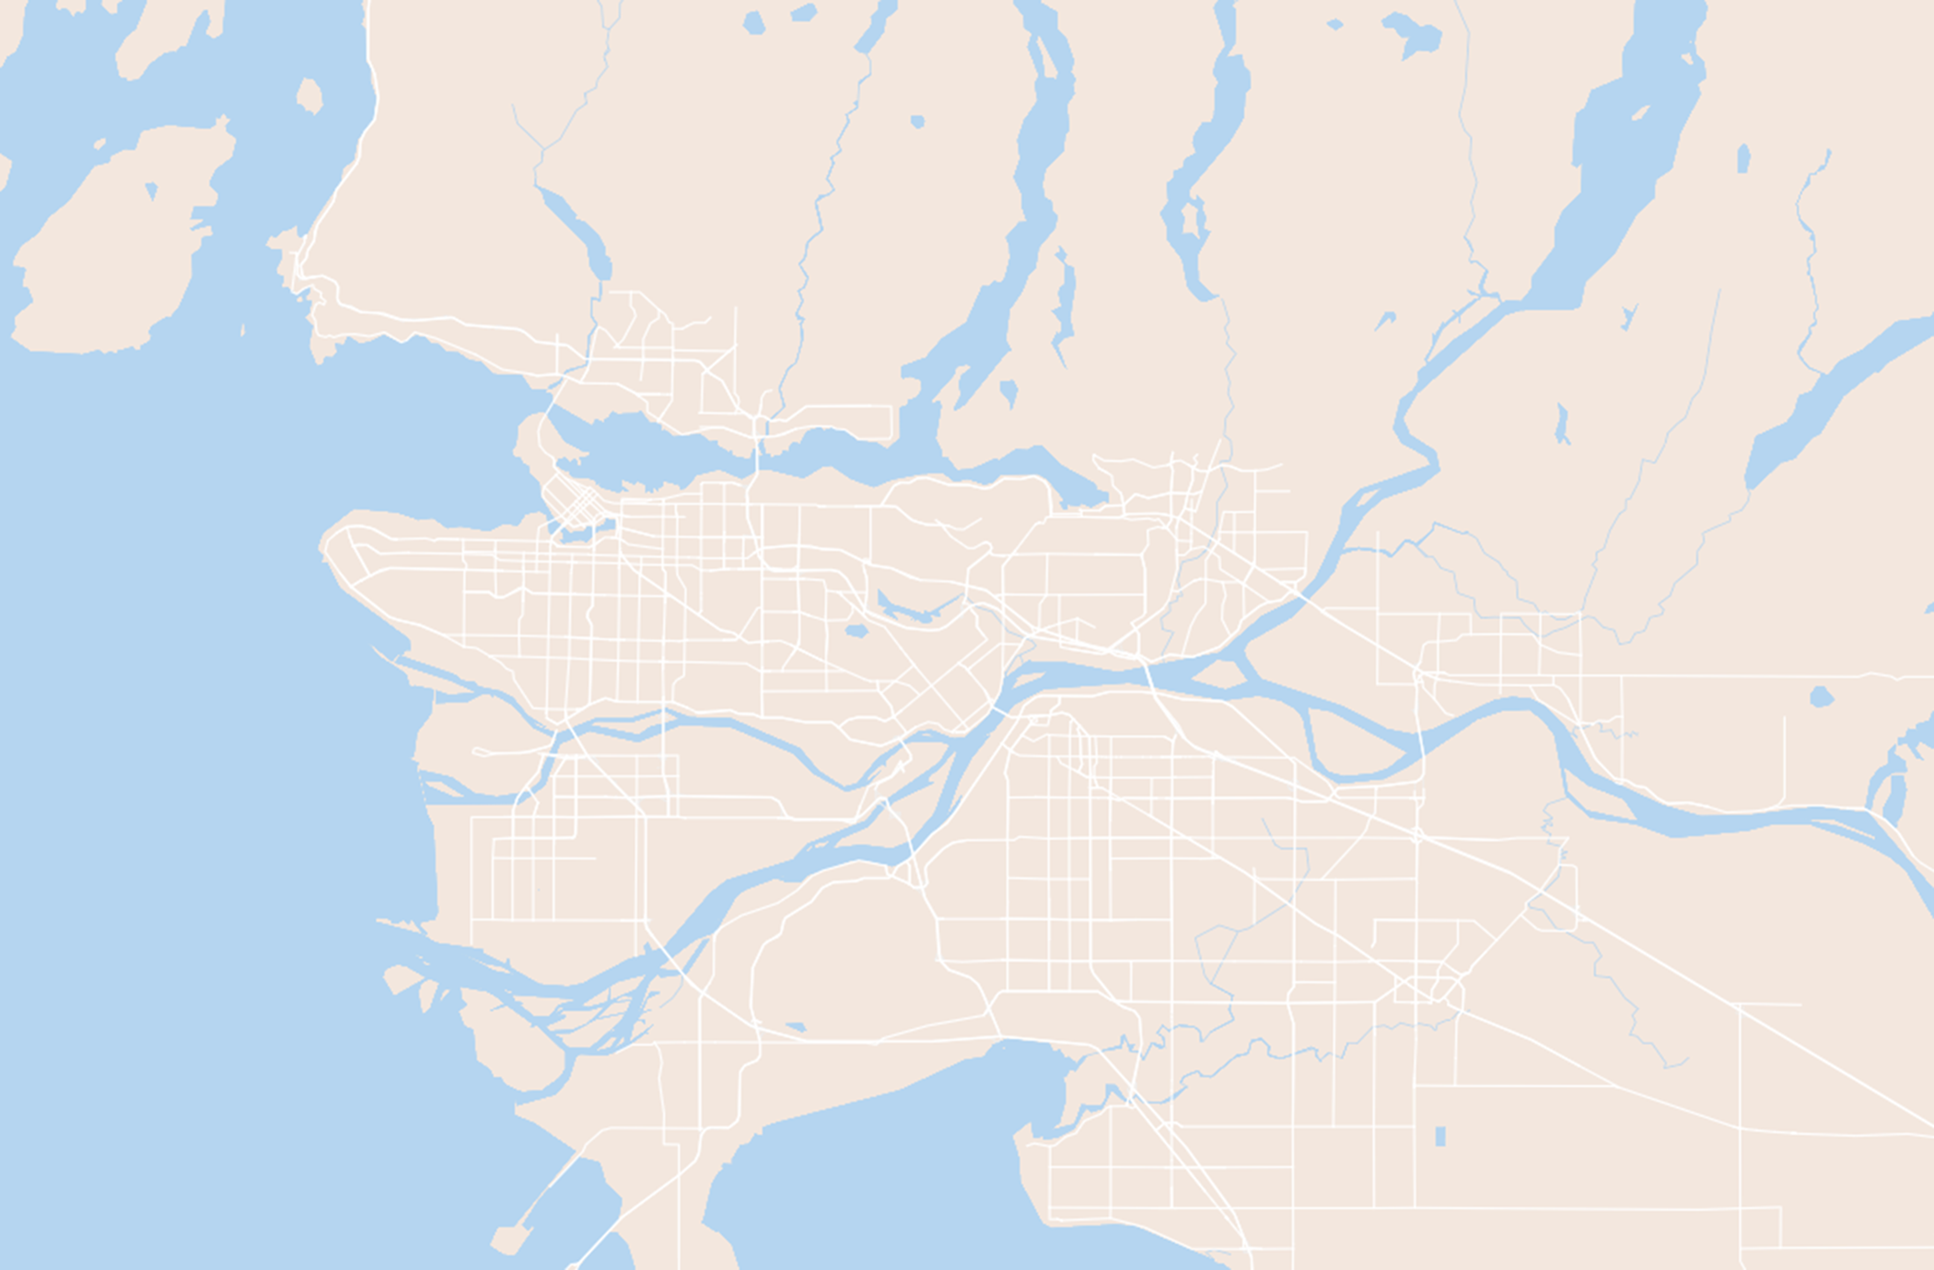
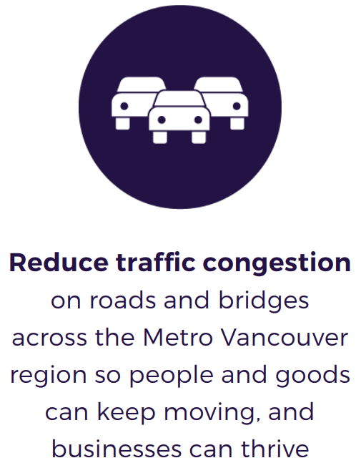
Price-setting in the absence of clear focus
How bad is congestion?
How is congestion defined and measured?
Where should it be reduced?
When should it be reduced?
By how much should it be reduced?
5
8
7
6
3
2
4
1

Slide 8
How are the rates set in theory?
Congestion charge should be equal to the costs that motorists impose upon society - Marginal Social Cost (MSC)
Ensures avoiding overcharge
Provides a benchmark to compare between scenarios
Provides useful insight into different values: paying by use vs. by congestion contribution

Slide 9
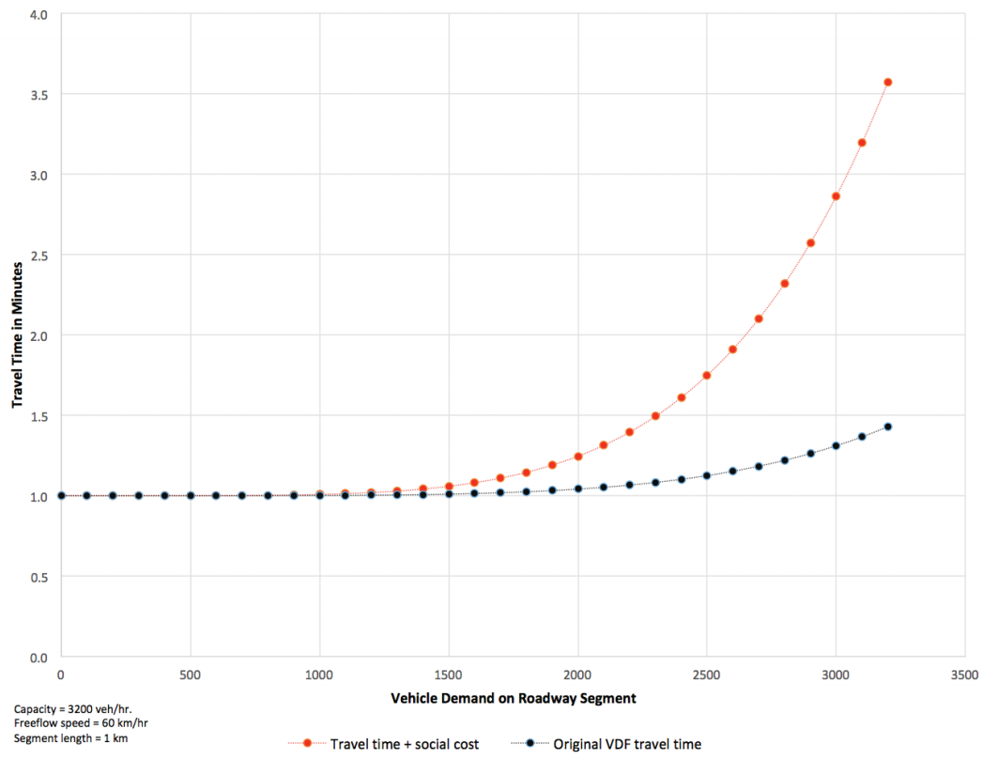
Optimal Price-setting
Travel time with original VDF and MSC VDF
A system optimum assignment was developed to approximate the MSC.
The VDFs estimate travel time on a road network link given its free-flow speed, capacity, and vehicle demand.
In application, the MSC is the first derivative of the VDF with respect to vehicle demand.
The MSC cost in minutes is converted into dollars using weighted average values of time (VOT).
MSC cost in minutes

Slide 10
Scenario development and iterations (point charges)
CBD:
CBD ($5)
CBD (MSC)
Bridges:
Bridges ($1; $5)
Bridges (TOD)
Bridges (TOD + Dir.)
Bridges (% MSC)
Bridges + NR (% MSC)
Comparisons:
Baseline scenario
‘Pure’ MSC scenario

Slide 11
Scenario development and iterations (dist.-based charges)
DBC:
DBC – flat ($0.10/km; $0.12/km; $0.15/km)
DBC (TOD)
DBC (TOD) – 2 zones
DBC (TOD) – 2 zones transit (% MSC)
DBC 8 zones (% MSC)
Comparisons:
Baseline scenario
‘Pure’ MSC scenario
Zone 8
Zone 8
Zone 3
Zone 8
Zone 8
$$/km
Zone 1
Zone 2
Zone 8
Zone 7
Highest charge rates
Zone 4
Zone 5
$/km
Zone 6
Zone 8
Lowest charge rates
Zone 8
Zone 8

Slide 12
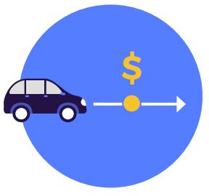
Illustrative concepts
A regional congestion point charge with charge points at or close to some or all of the regionally important crossings, complemented by further charges at locations within the Burrard Peninsula.
Range of charge rates per crossing:
Min scenario:
AM peak: $0.85 - $4.30
Off peak: $0.36 - $1.06
PM Peak: $1.03 - $5.52
Min+ scenario:
AM peak: $1.27 - $6.45
Off peak: $0.62 - $1.59
PM Peak: $1.54 - $8.27

Slide 13
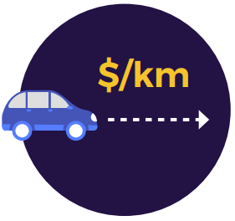
Illustrative concepts
A distance-based charge with two or more zones with varying charge rates throughout Metro Vancouver.
Range of charge rates per km:
Min scenario:
AM peak: $0.02 - $0.25/km
Off peak: $0.02 - $0.07/km
PM Peak: $0.03 - $0.27/km
Min+ scenario:
AM peak: $0.03 - $0.38/km
Off peak: $0.03 - $0.11/km
PM Peak: $0.04 - $0.40/km
Zone 8
Zone 8
Zone 3
Zone 8
Zone 8
Zone 1
Zone 2
Zone 8
Zone 7
Highest charge rates
Zone 4
Zone 5
Zone 6
Zone 8
Lowest charge rates
Zone 8
Zone 8

Slide 14
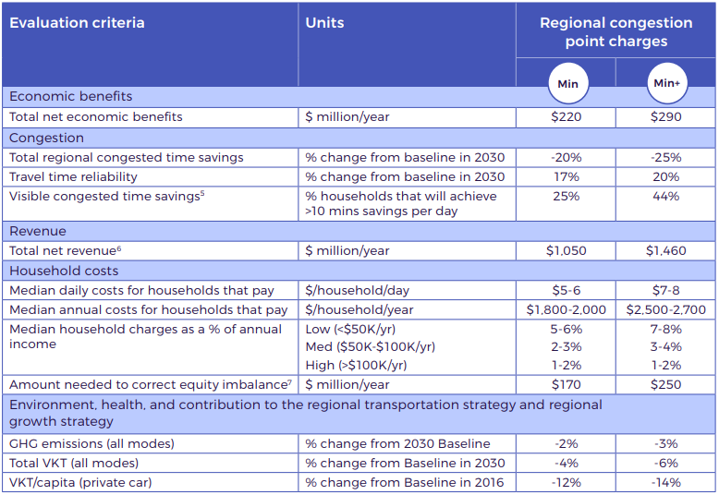
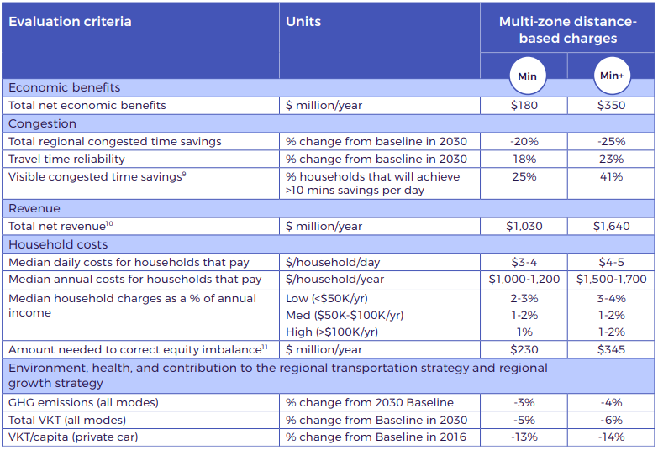
Evaluation results
Congestion: These scenarios have the potential to reduce congestion by 20-25%, while improving travel time reliability by 17-23%
Fairness: It is estimated that it would cost the average paying household between $3 - $8 per day
Revenue: These scenarios have the potential to raise between $1 - $1.6 billion in net revenues per year

Slide 15
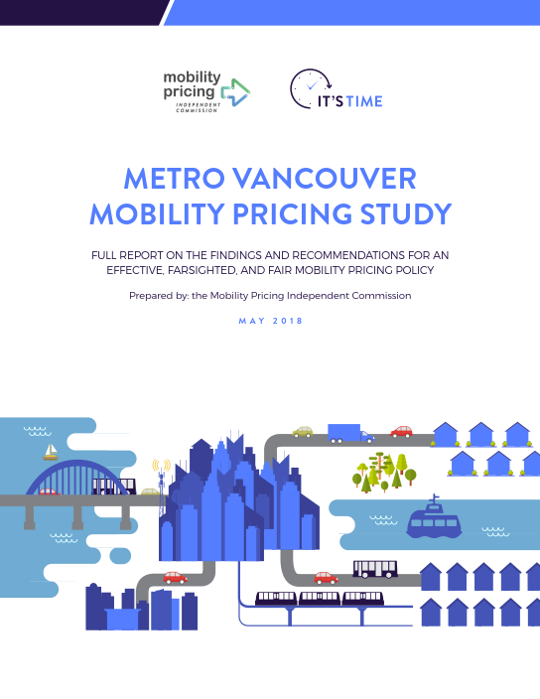
Next steps
Further research and evaluation to understand issues and impacts around…
Equity/Affordability/Accessibility
Business and Regional Planning impacts
Coordinated pricing
New mobility
Performance targets
Policy principles
Administration
Technology costs and timelines
Pilot studies
Final Report: https://www.translink.ca/Plans-and-Projects/Mobility-Pricing.aspx
It’s Time website: https://www.itstimemv.ca/

Slide 16
Thank you!
Final Report: https://www.translink.ca/Plans-and-Projects/Mobility-Pricing.aspx
It’s Time website: https://www.itstimemv.ca/
Fearghal King, PhD Senior Transportation Planner, Mobility Pricing Transportation Planning & Policy TransLink Tel: +1 778-375-7621 Email: fearghal.king@translink.ca
Web: www.translink.ca

